Slide 1
Introduction
Yuechen He From Sep 8th to Sep 9th, 2024

Slide 2
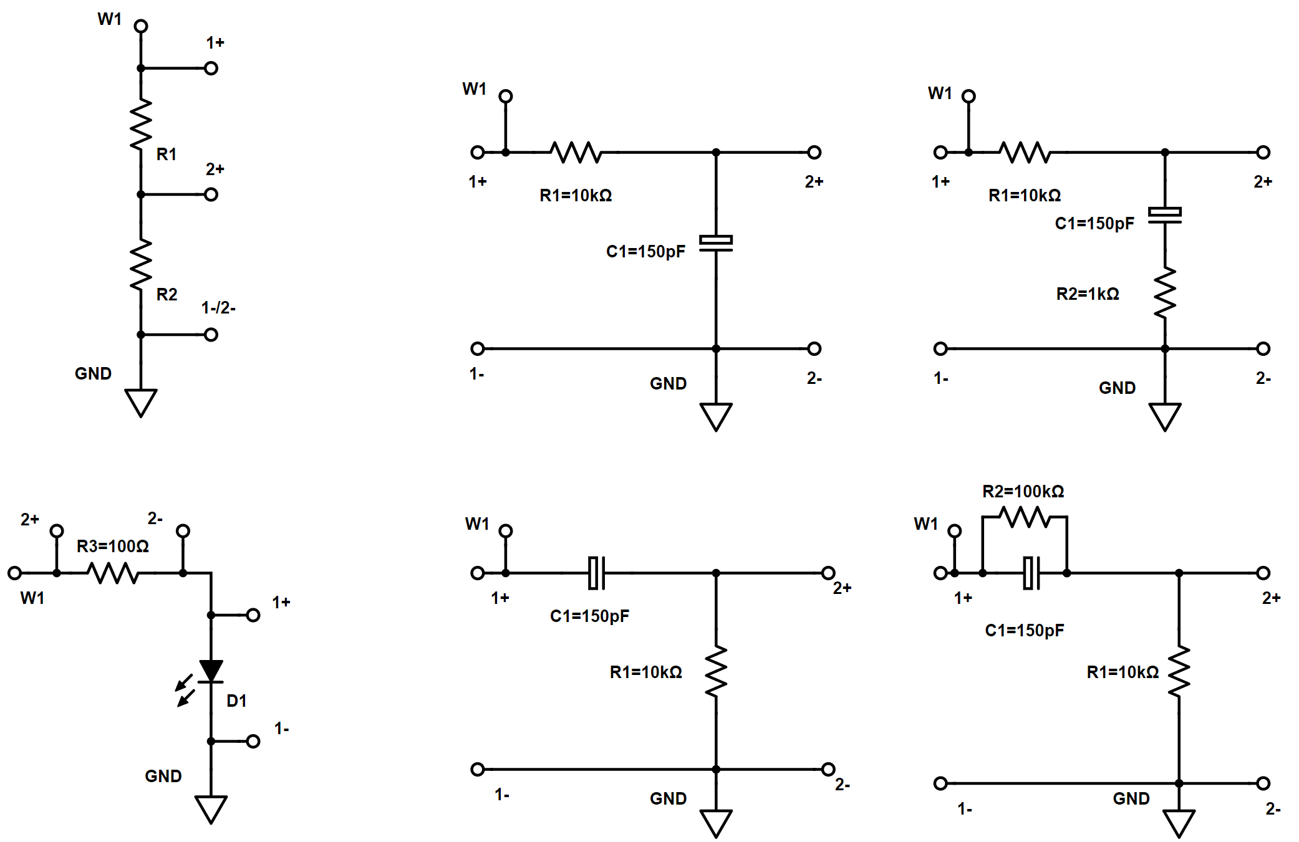
R Divider
A
C
LED
B
D

Slide 3
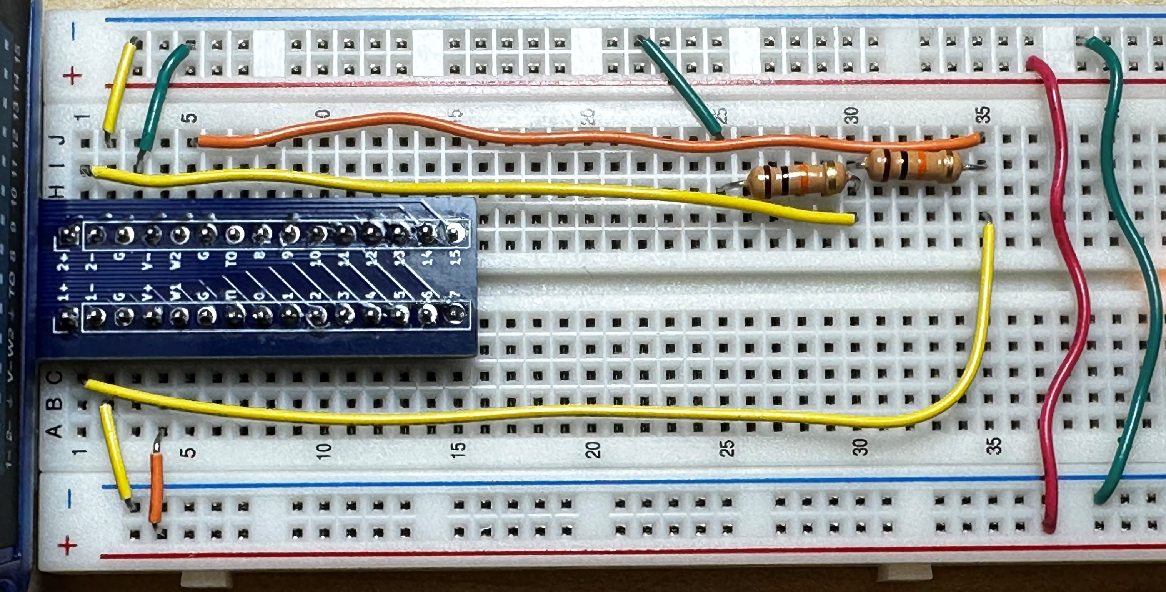
Green -> VSS ;Red -> VDD; Yellow -> Oscilloscope; Orange-> Signal Generator
Notes:
Ramp_X_Y_Resistor_Devider

Slide 4
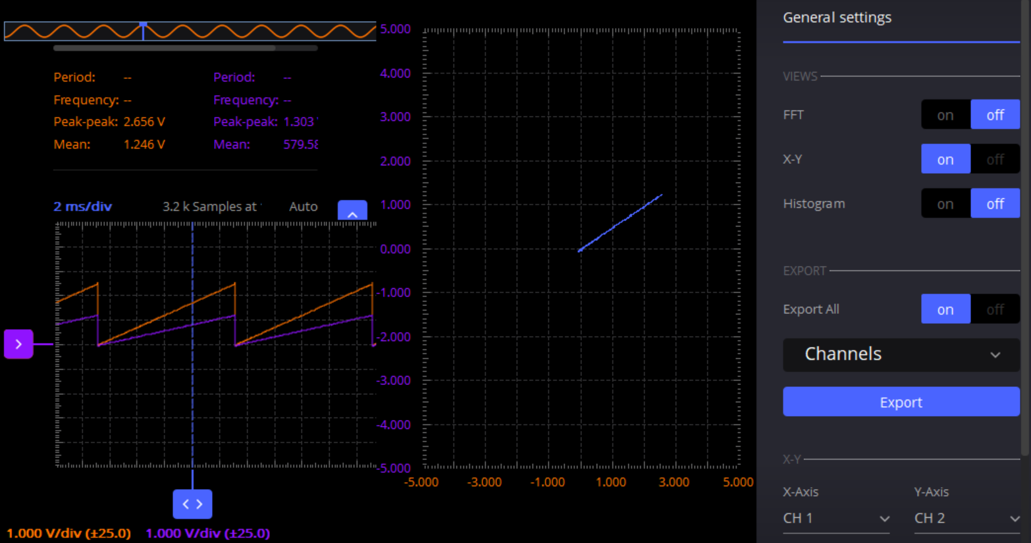
Oscilloscope: Waveforms and X-Y plot
Notes:
Resistor Divider

Slide 5
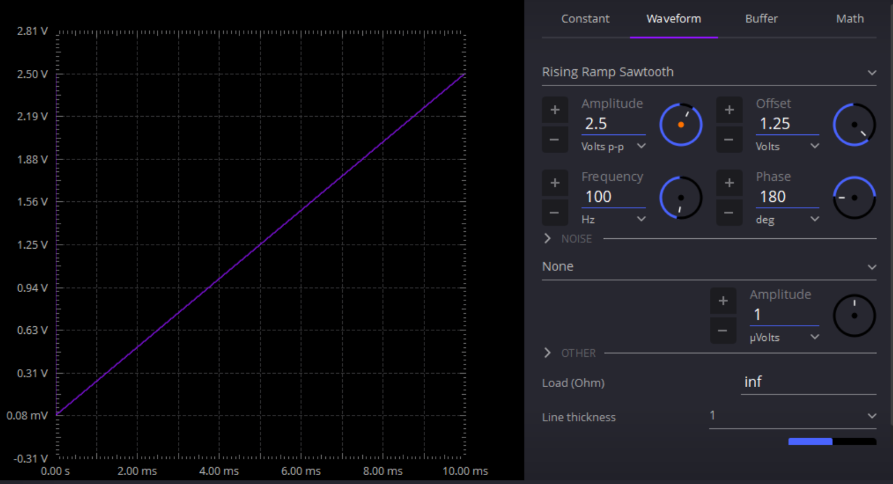
W2: 100Hz 0-2.5V Ramp Signal
Notes:
Resistor Divider

Slide 6
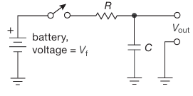
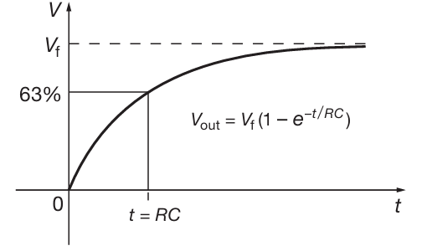
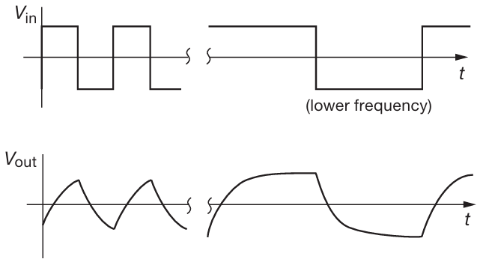
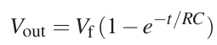
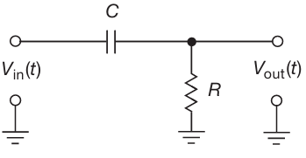
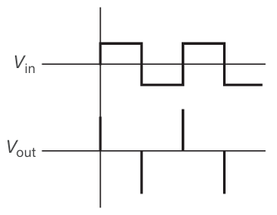
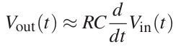
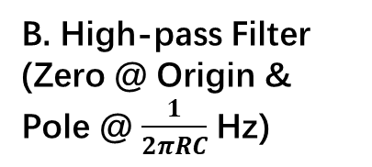
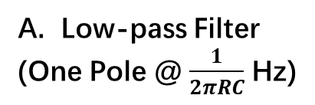
Low-pass Filter
(One Pole @ $\frac{1}{2πRC}$ Hz)
B. High-pass Filter
(Zero @ Origin & Pole @ $\frac{1}{2πRC}$ Hz)

Slide 7
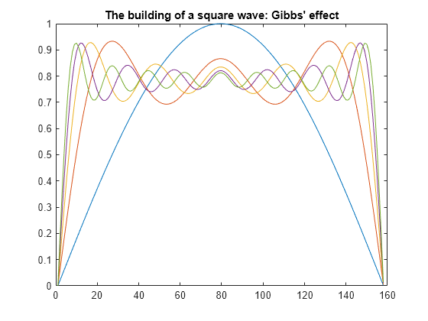
PK’s advice: Too much irrelevant information!!!!!!
One Slide->Only one topic
C. Square Wave Spectrum
Notes:
My bad!

Slide 8
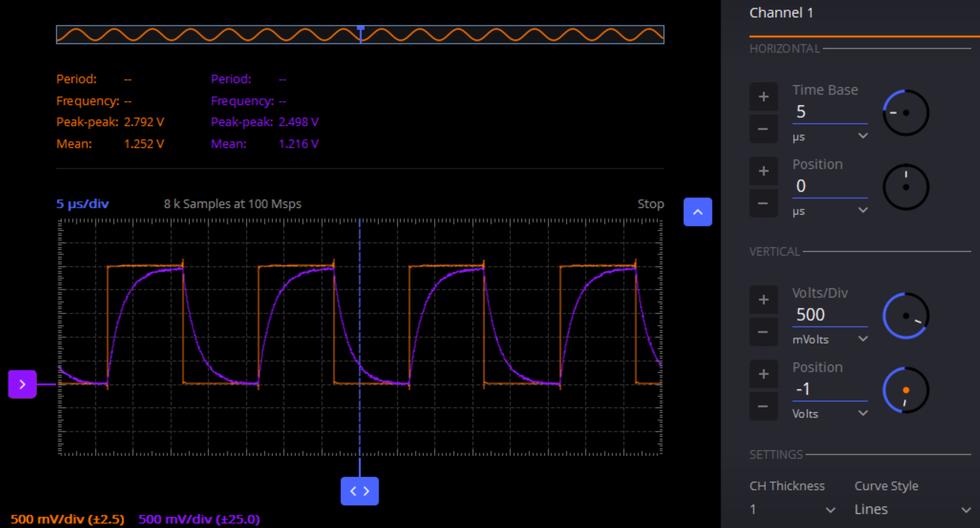
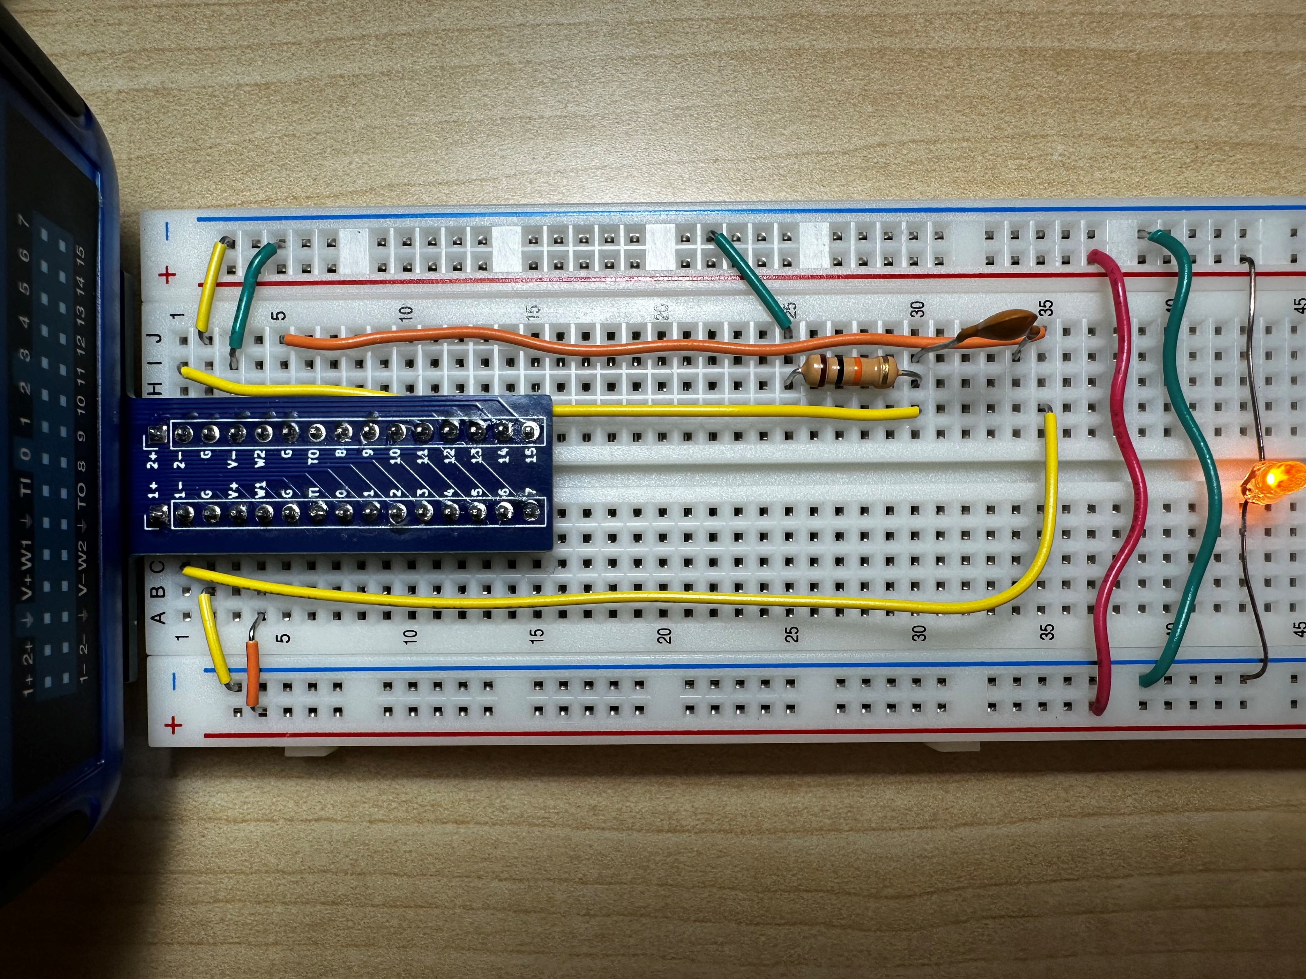
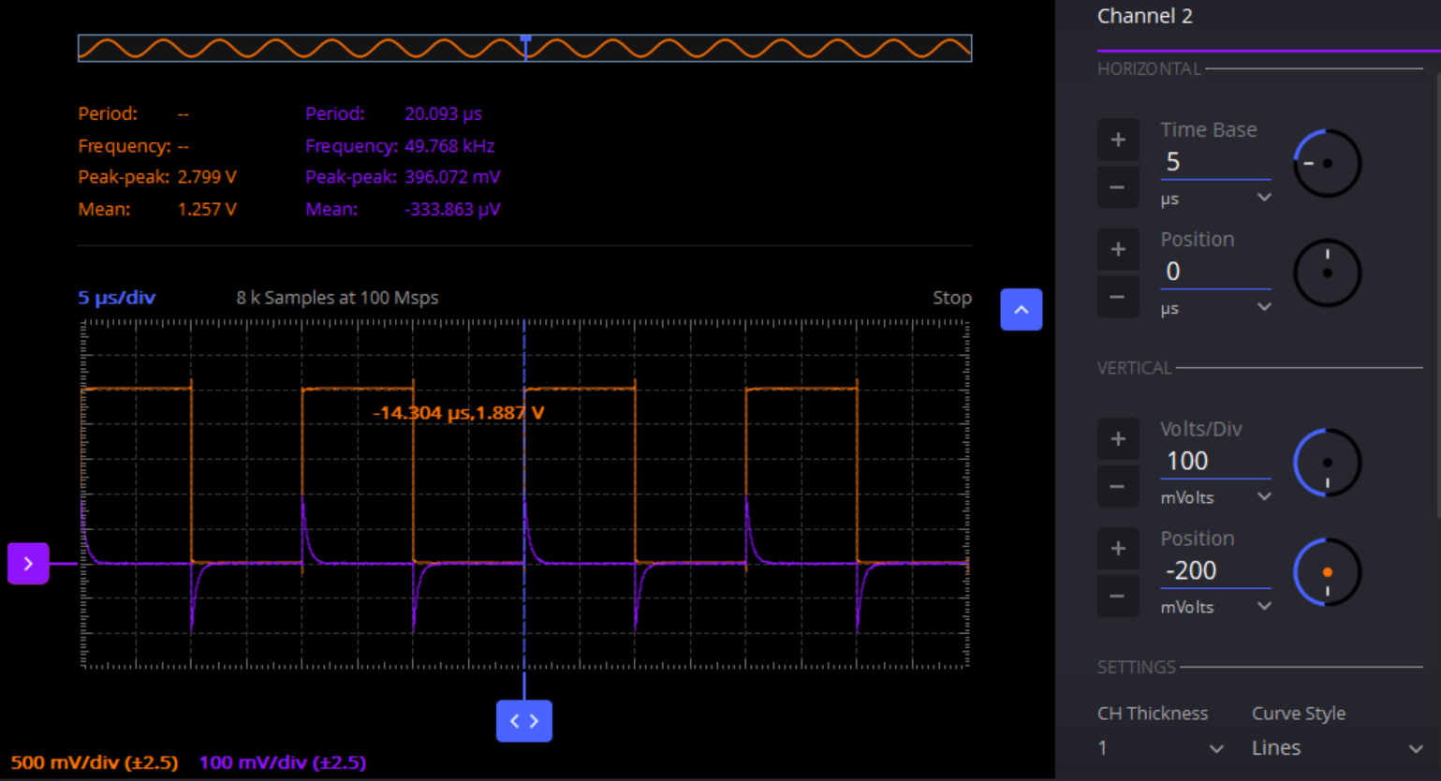
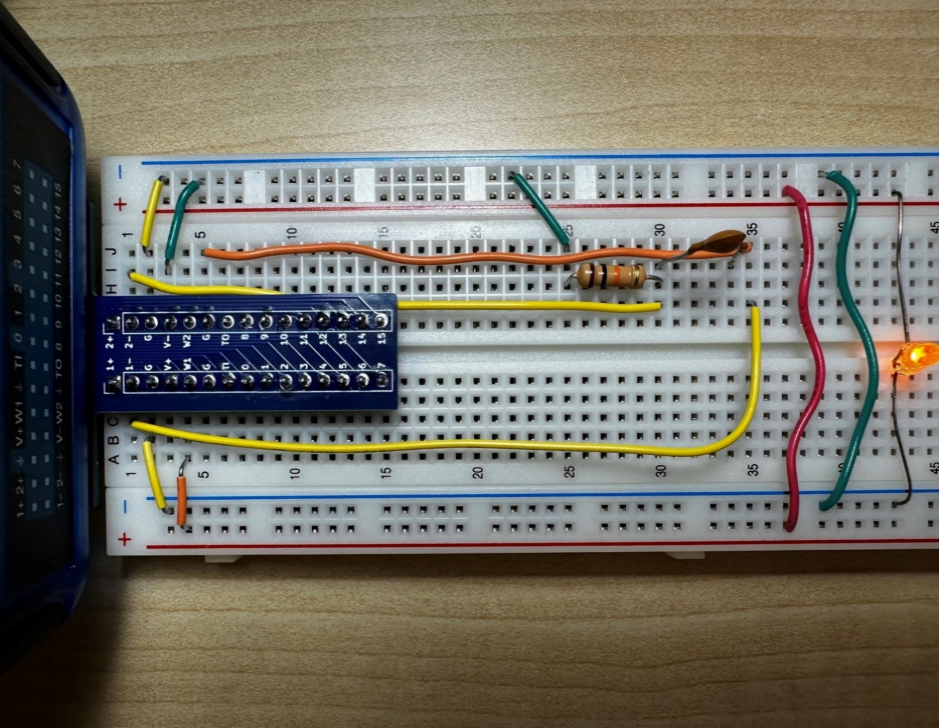
Low-pass Filter
(One Pole ~100kHz)
B. High-pass Filter
(Zero @ Origin & Pole ~100kHz)

Slide 9
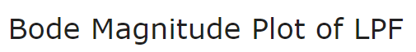
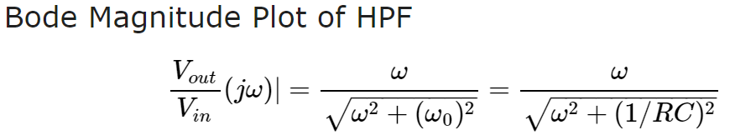
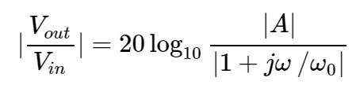
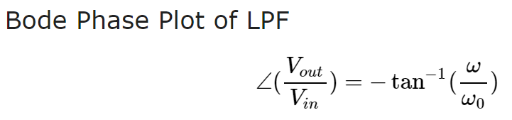
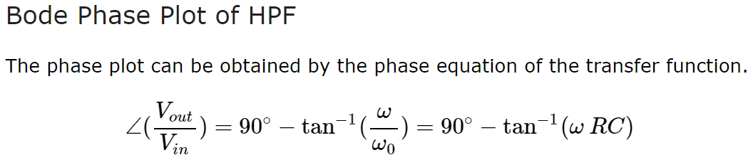
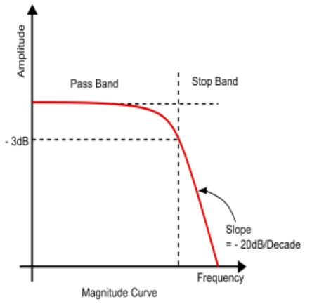
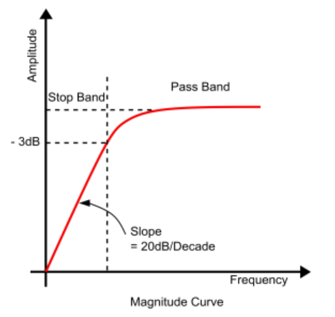
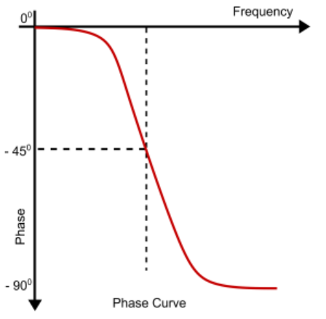
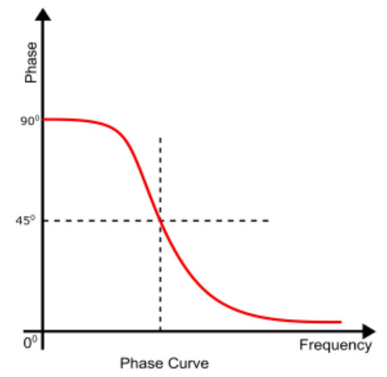
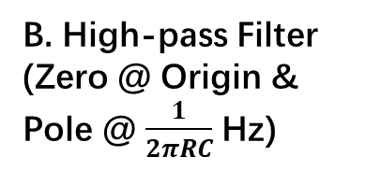
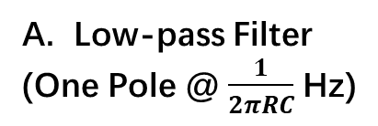
Low-pass Filter
(One Pole @ $\frac{1}{2πRC}$ Hz)
B. High-pass Filter
(Zero @ Origin & Pole @ $\frac{1}{2πRC}$ Hz)

Slide 10
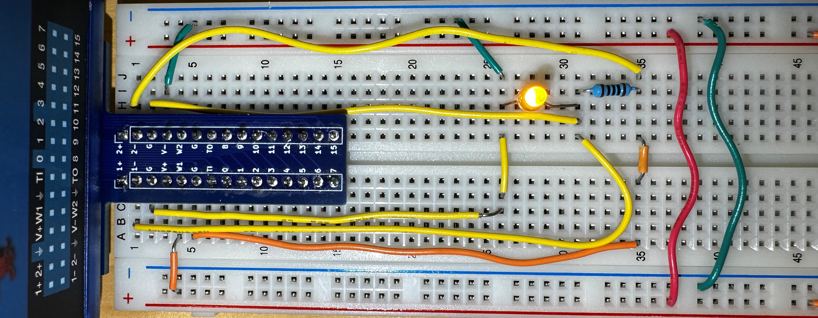
Green -> VSS ;Red -> VDD; Yellow -> Oscilloscope; Orange-> Signal Generator

Slide 11
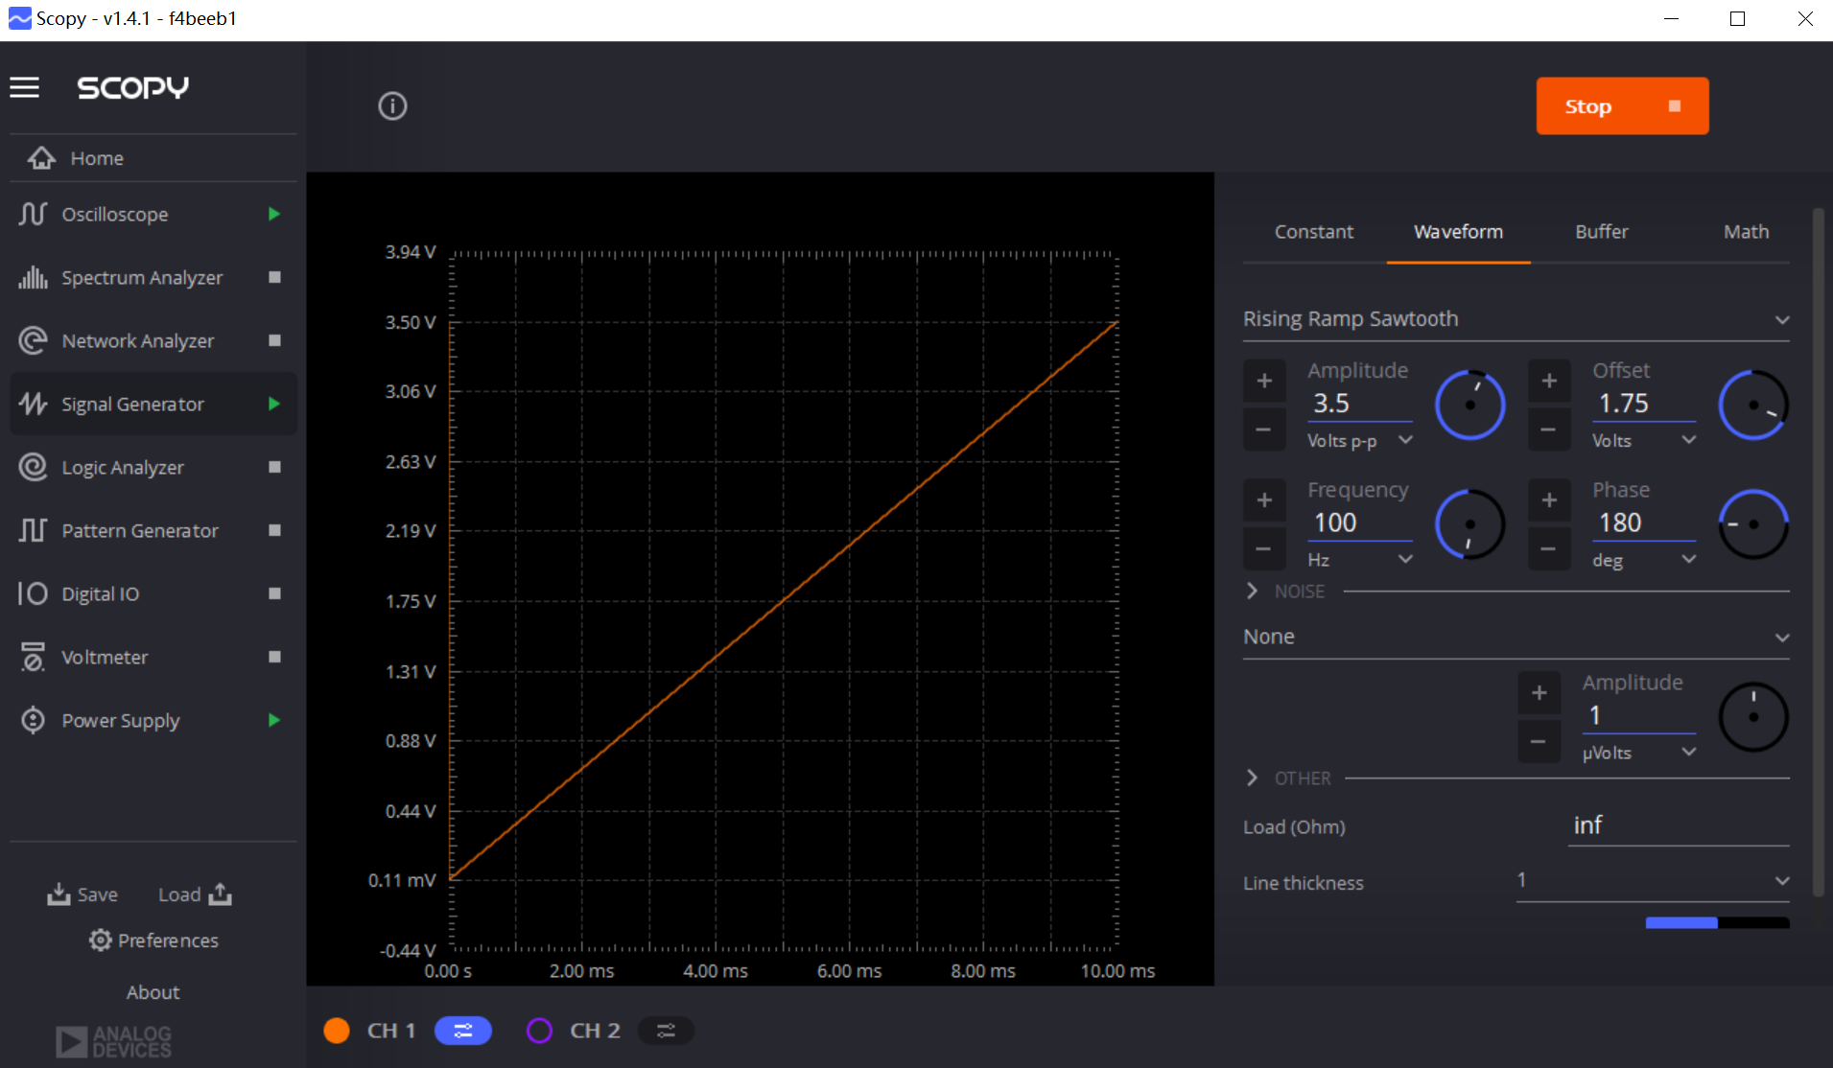
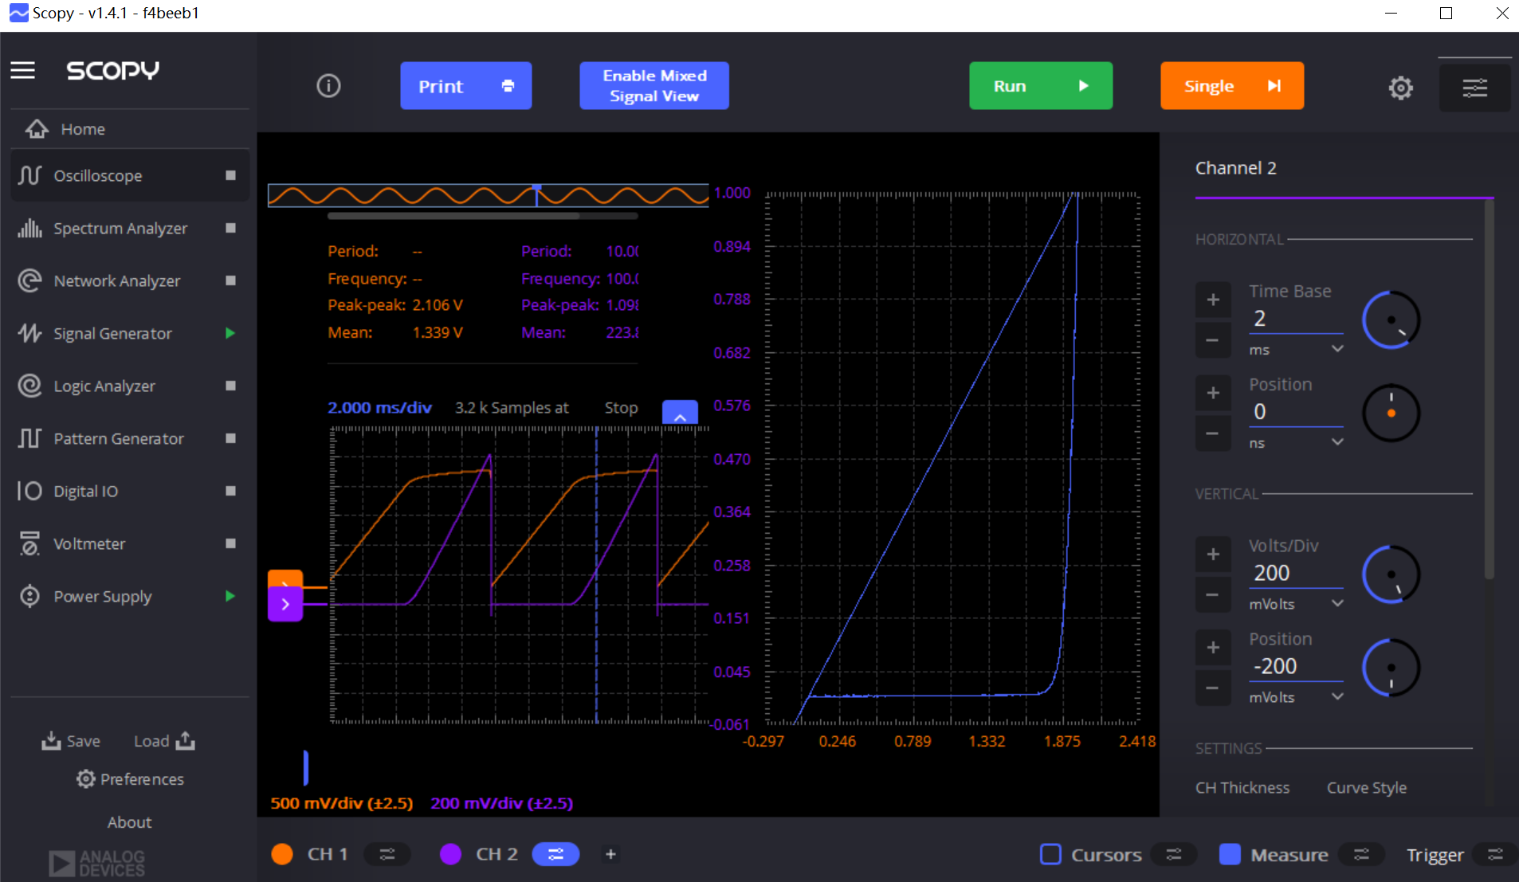
W1:0-3.5V 100Hz Ramp Signal Generation
Oscilloscope: X-Y Plot of LED Diode

Slide 12
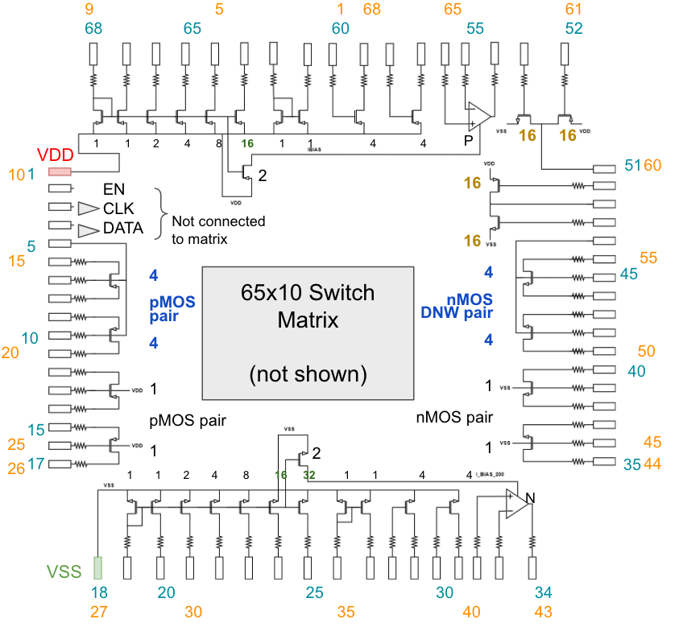
DNW NMOS
Notes:
Common source amplifier.

Slide 13
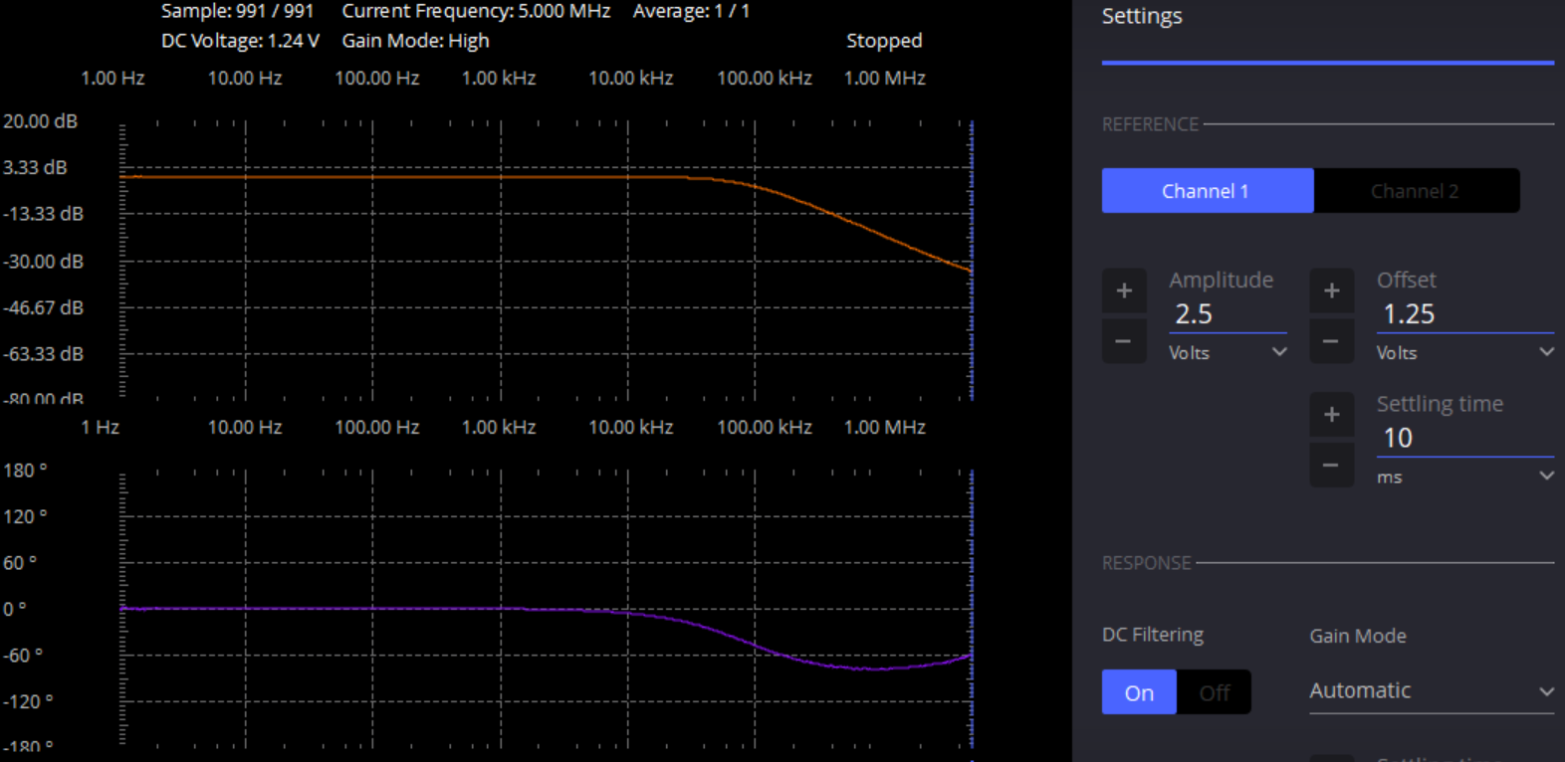
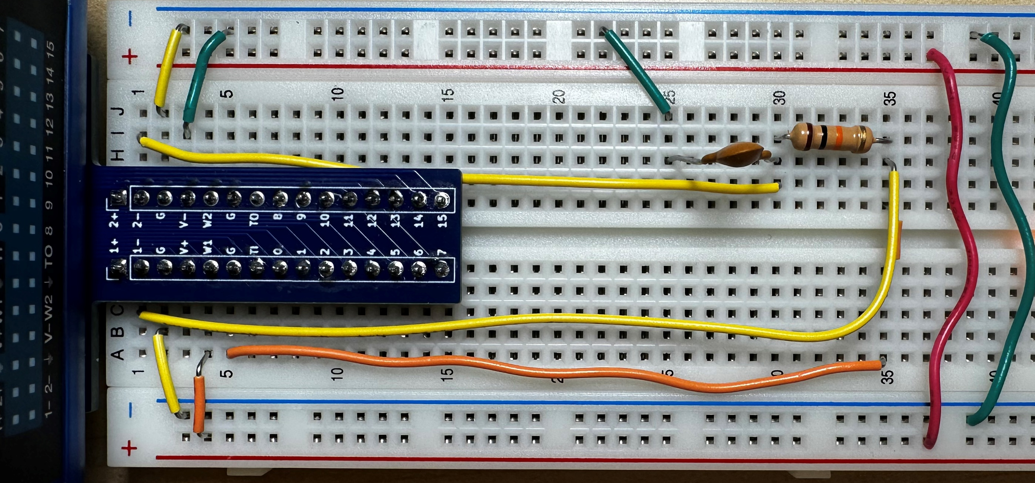
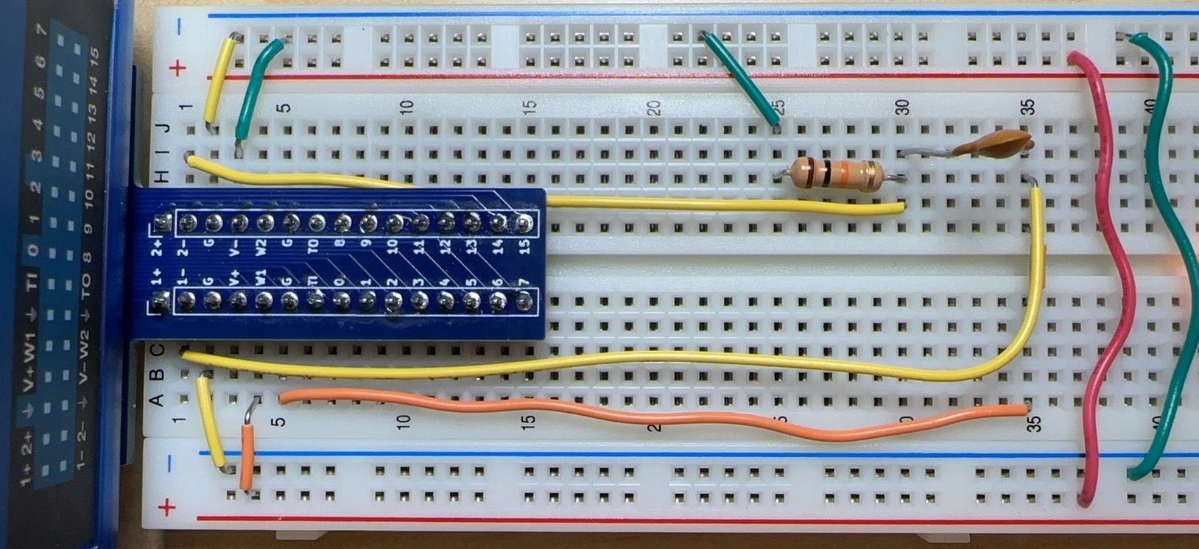
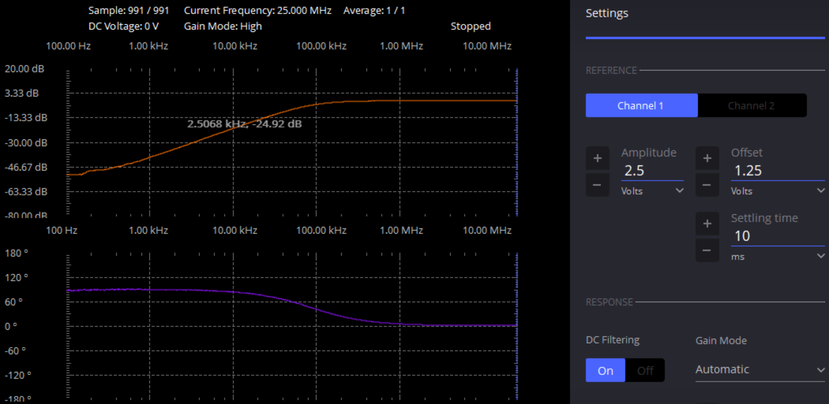
Low-pass Filter
(One Pole ~100kHz)
B. High-pass Filter
(Zero @ Origin & Pole ~100kHz)

Slide 14
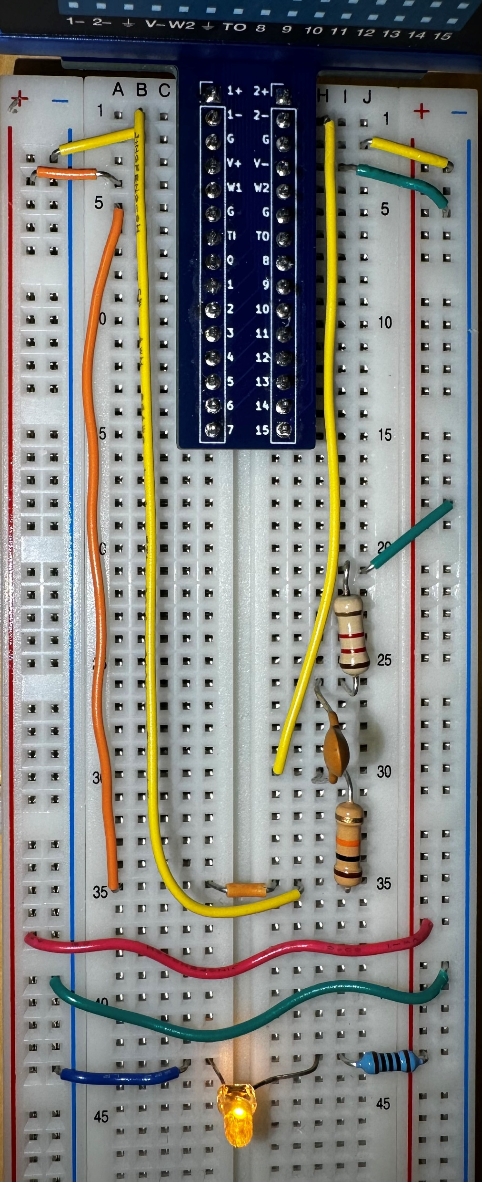
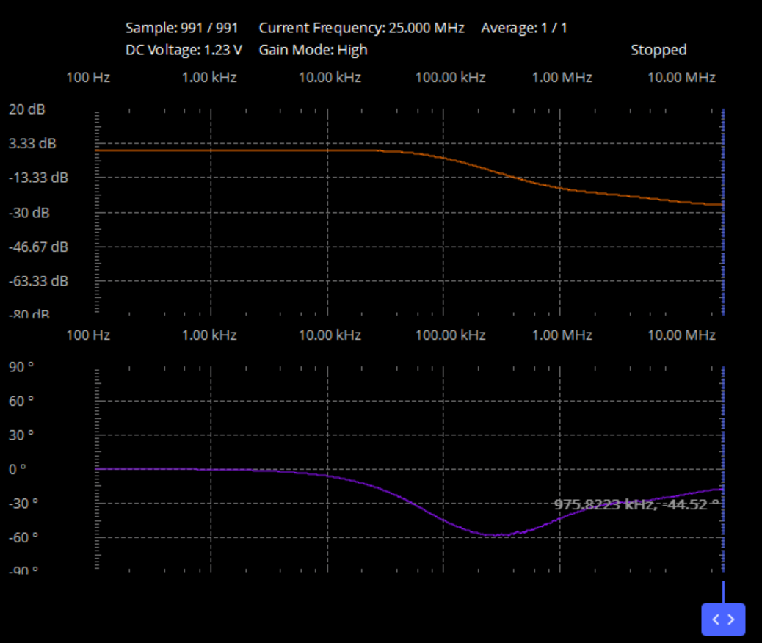
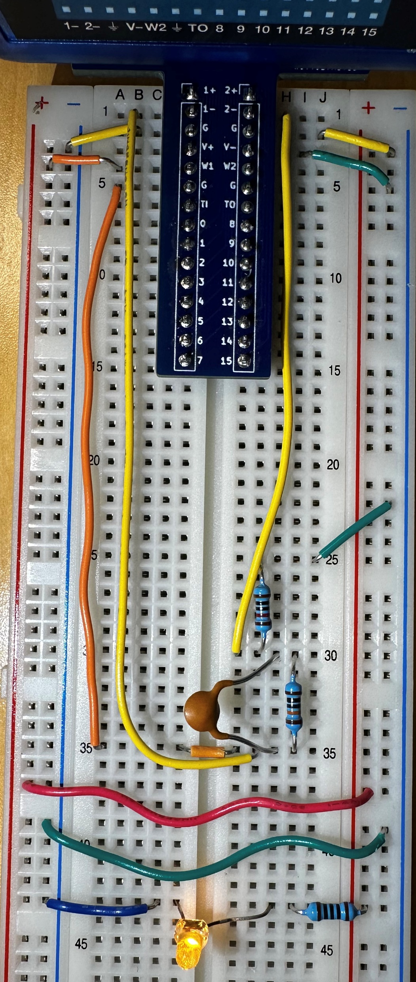
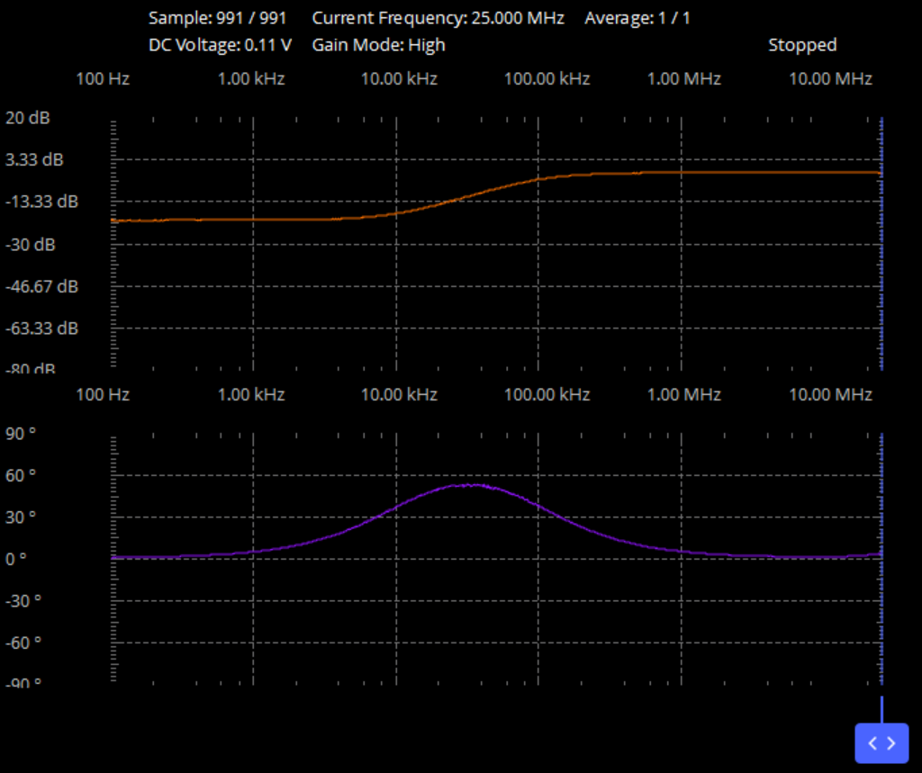
C. Pole ~100kHz & Zero ~1MHz
D. Pole ~100kHz & Zero ~10kHz

Slide 15
Current Mirror
Yuechen He From Aug 2nd to Aug 28th, 2024

Slide 16
Two X4 PMOS
Two X4 NMOS
Two X4 PMOS
Two X4 NMOS
Notes:
Pin Map of Current Mirror

Slide 17
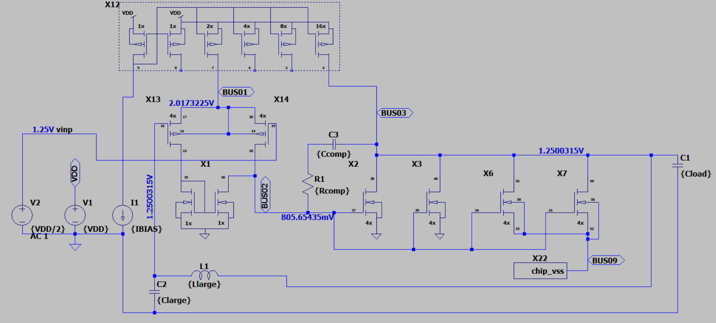
66
8
11
7
10
5
6
9

Slide 18
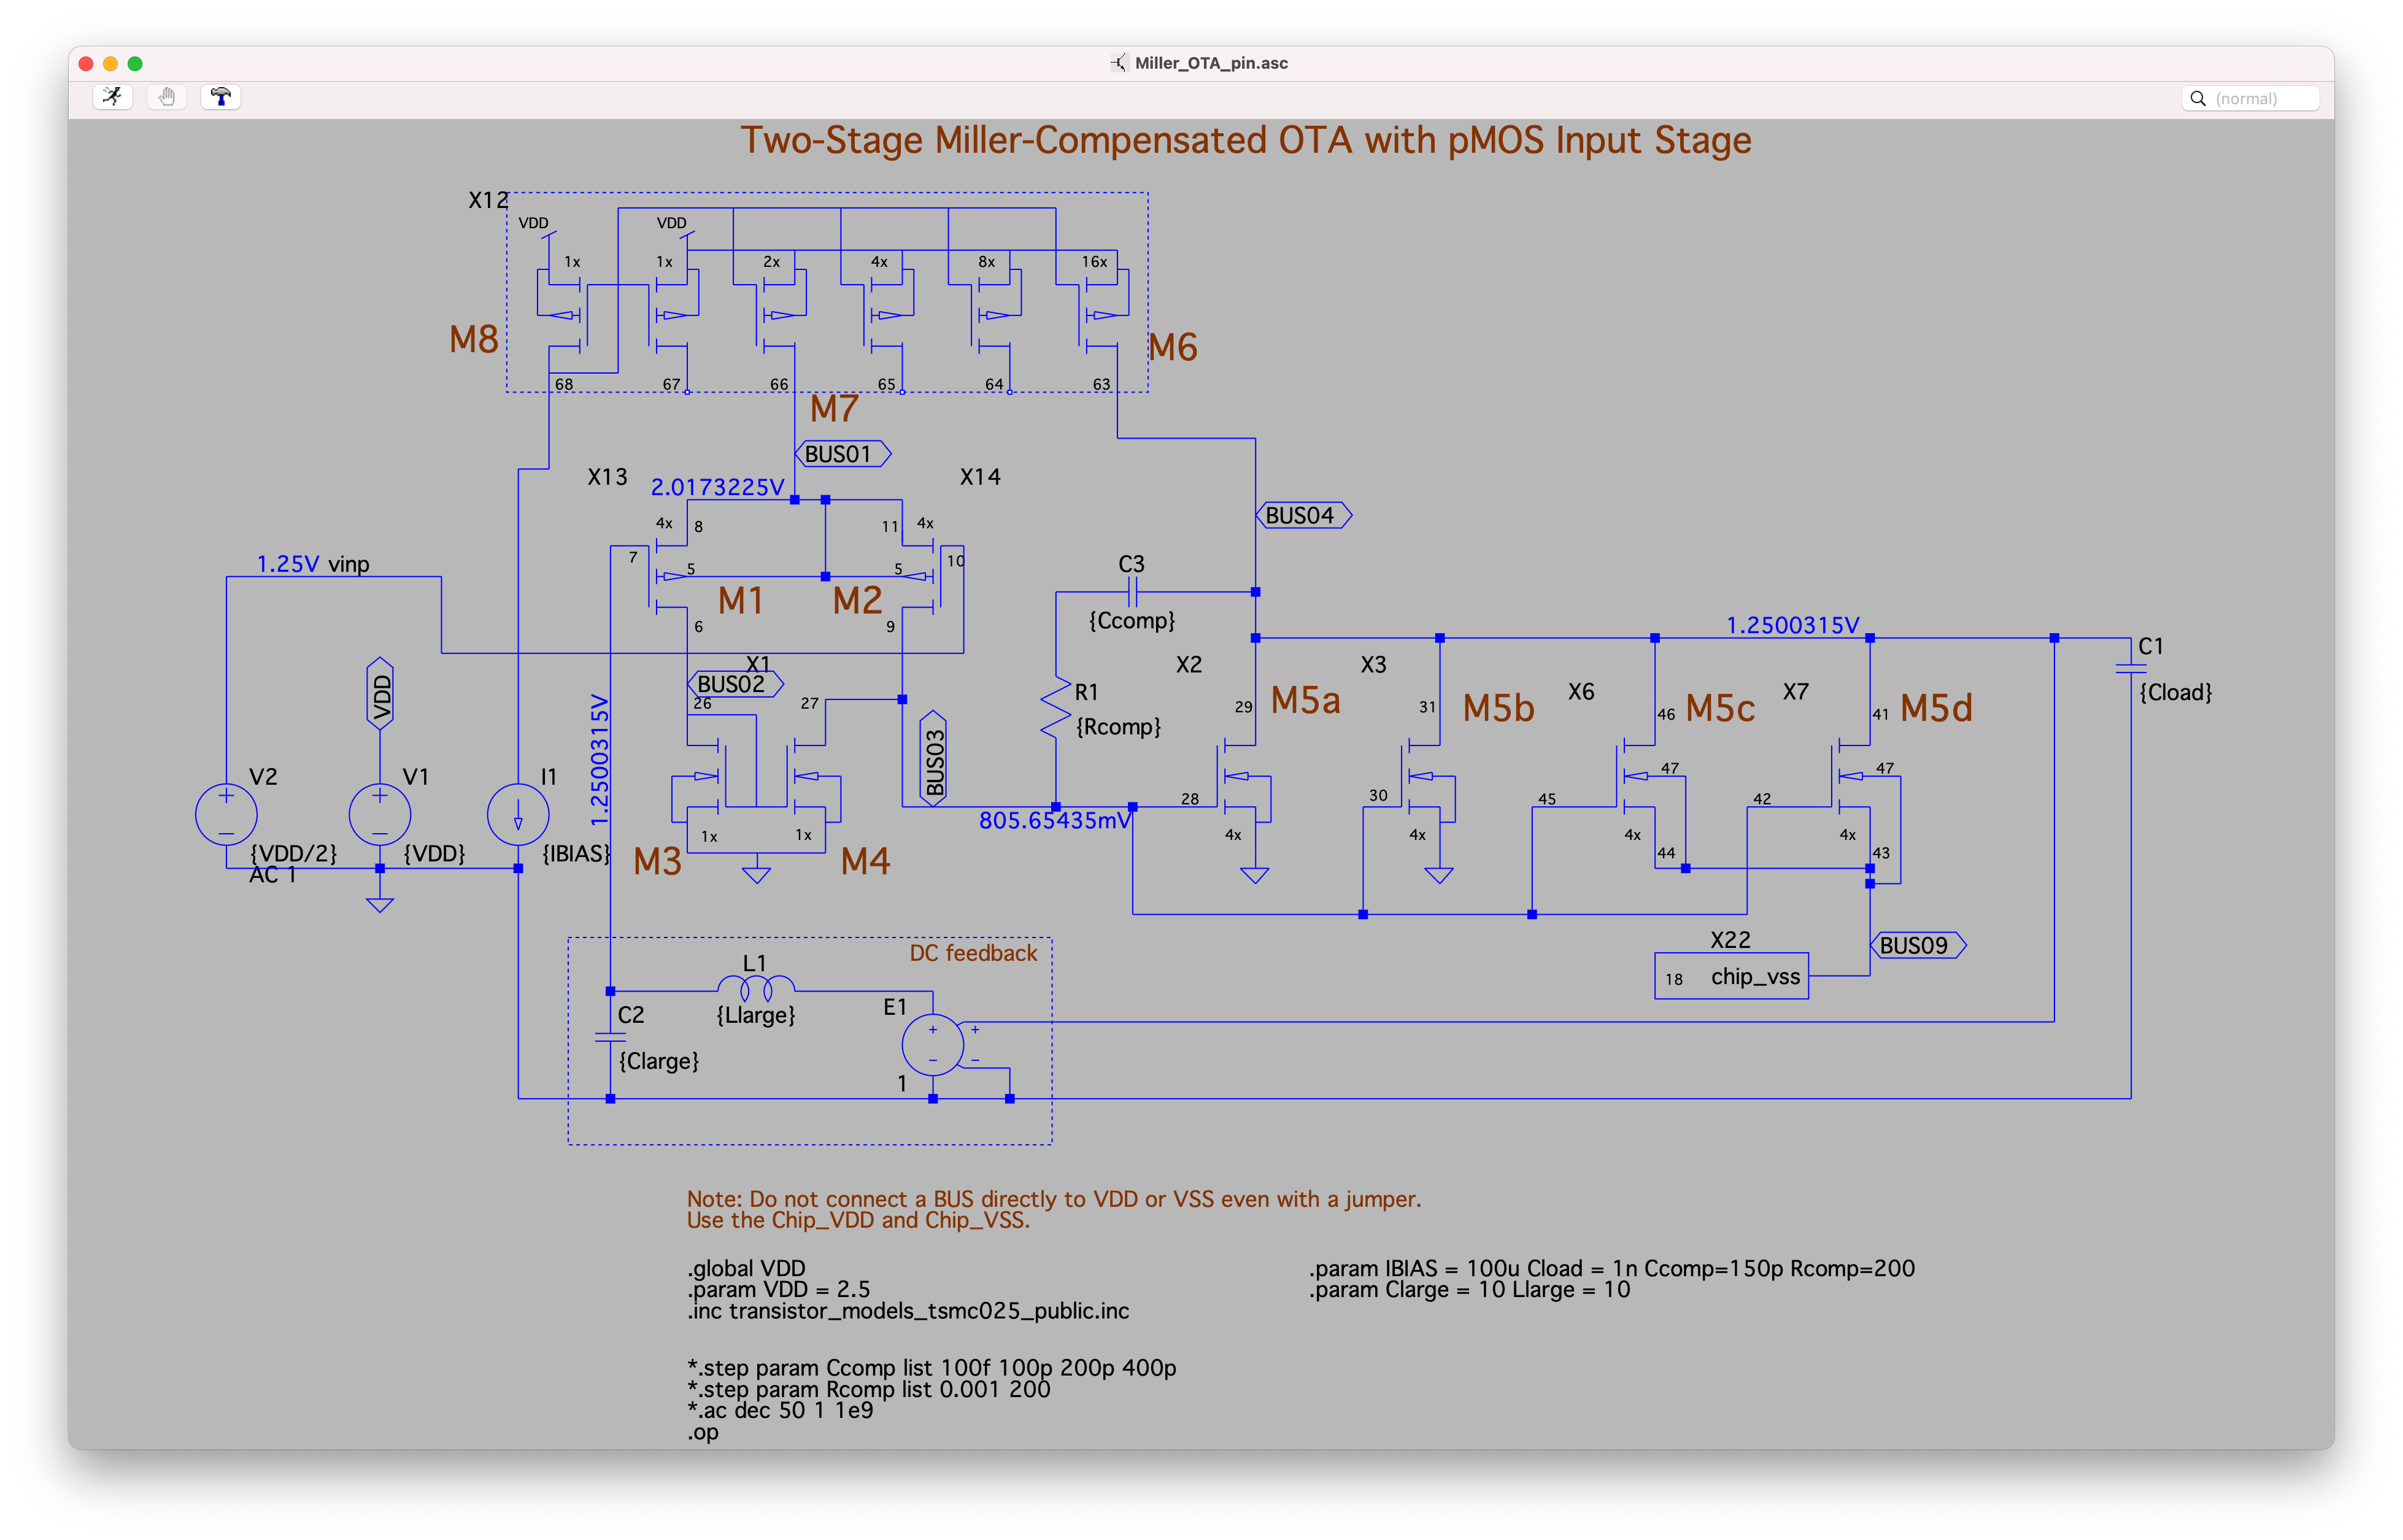

Slide 19
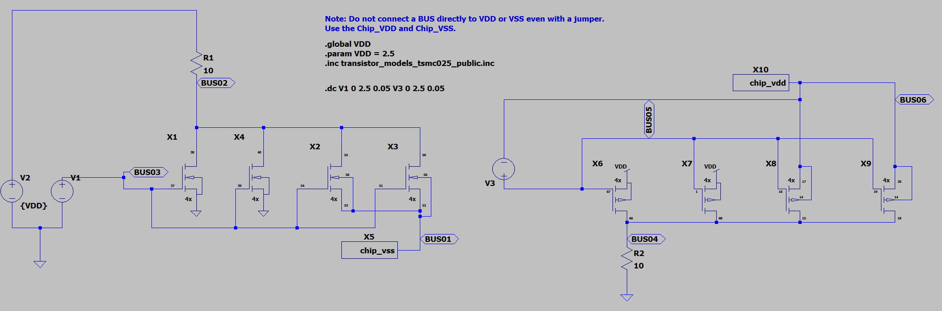
Source: VDD
Drain: Pin 29, 31, 41, 46
Gate: Pin58, 60, 7, 10
Gate: Pin 28, 30, 42, 45
Drain: Pin57, 59, 6, 9
Source: VSS

Slide 20
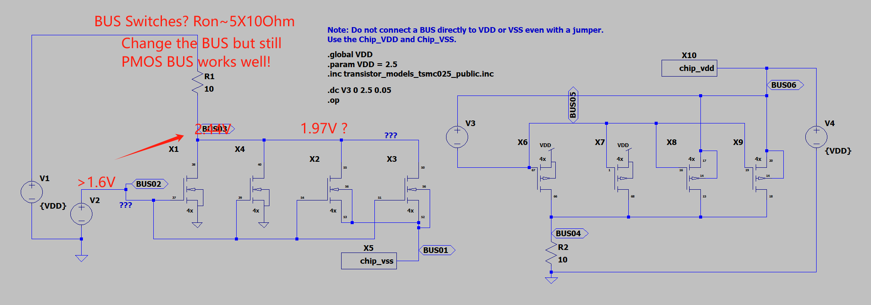

Slide 21
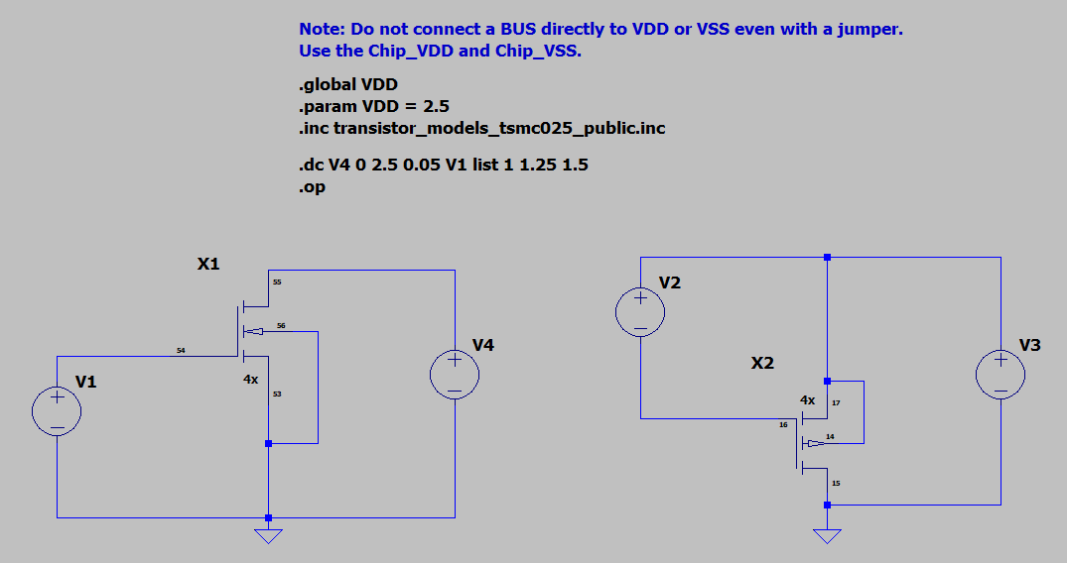
Drain: 46
Bulk: 47
Gate: 42
Source: 8
Bulk: 5
Gate: 7
Source: 44
Drain: 6

Slide 22
PMOS Current Mirror
NMOS Current Mirror
Notes:
The current mirrors used in this experiment; blue pin numbers correspond to the numbers on the PCB.

Slide 23
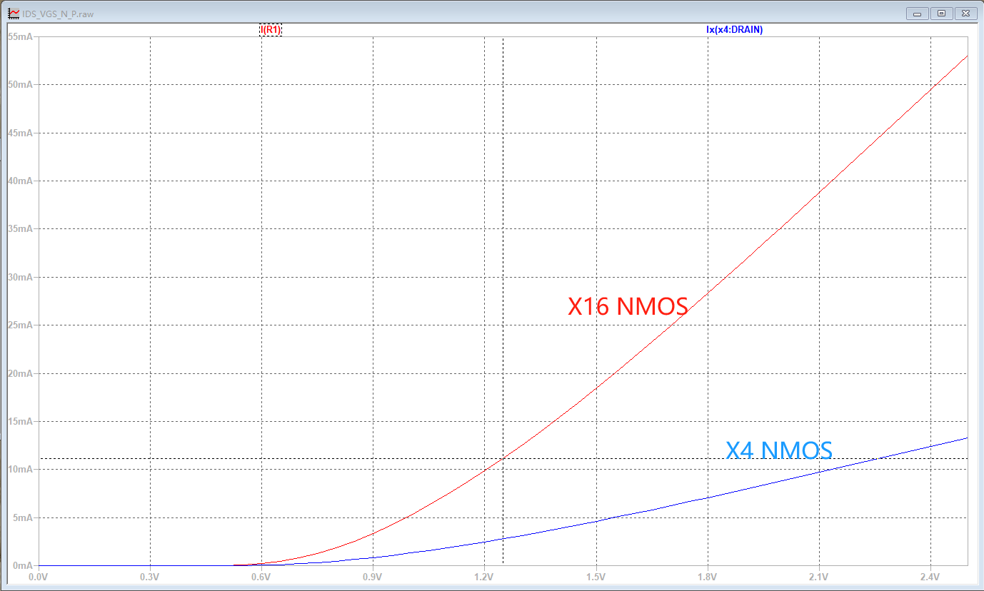
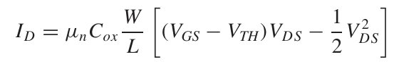
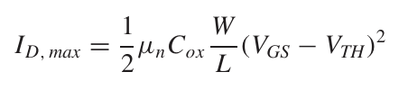
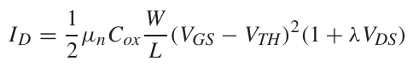




IDS
IDS-VGS Curve of X4 and X16 NMOS @ VDS=2.5V
I-V Characteristics
Tips:
1. Vth~0.6V
2. Width*4 -> IDS*4
VGS
Working Regions
IDS
Channel-Length Modulation
IDS-VDS Curve of X4 NMOS
VDS
Notes:
Single transistor characteristics. IDS-VGS/VDS plot of NMOS transistors, square law, channel-length modulation and operating regions.

Slide 24


Fixed IBIAS=200uA，IDS-VDS
IDS
1:1
1:2
1:4
1:8
1:8->1.6 mA
VDS=0.9V
1:4->0.8 mA
1:2->0.4 mA
VDS=0.9V
1:1->0.2 mA
VDS
Notes:
Current mirror (1:1, 1:2, 1:4, 1:8) I-V characteristics with fixed IBIAS 200uA.

Slide 25


IOUT
IOUT
IIN
IIN
Notes:
How to measure the current for NMOS and PMOS current mirror. IBIAS sweep.

Slide 26


IIN（Red）
IOUT（Blue）
IIN
IOUT
IIN From 100uA to 1.5mA
VG-> Same
VS-> Increase
10 Ohms
Notes:
Error verification for IBIAS Sweeping. A series resistor with several Ohms between the ground and the source of M2 can cause VGS dropping and thus ~30uA error when the current is larger than 1mA.

Slide 27

Fixed IBIAS
IOUT
VDS Sweep
0-2.5V
Notes:
Schematic for VDS Sweep and Measurement

Slide 28

Green Wires -> VSS ;Orange Wires-> VDD; Yellow Wires -> Oscilloscope
470 Ohm
20k Ohm Pot
470 Ohm
Notes:
Connections for 1:1 NMOS current mirror IBIAS sweeping

Slide 29


Triangle Wave from 0V to 4V
△V
0-4V
1s=10*100ms
Notes:
Settings in ADALM2000 to sweep the VDS from 0V to 2.5V. You need to make sure the "Time Base" is large enough for you to see your 1Hz trianlge signal. You can press "Single" button on the top right corner to get one cycle and change the horizontal/vertical scale to see them clearly.

Slide 30

Green -> VSS ;Orange -> VDD; Yellow -> Oscilloscope; Red-> Signal Generator
470 Ohm
200uA
Notes:
Connections for 1:1 NMOS current mirror VDS sweeping measurement. 1+ and 2+ channels are connected to the load resistor to measure the output current and VDS (Pin 20). W2 is one signal generator channel, which generates a ramp signal to sweep the VDS.

Slide 31

Ramp from 0V to 2.5V
0-2.5V
Notes:
Ramp Setting.

Slide 32



X-Y Plot
Export the Data
Notes:
XY Plot of VDS sweep

Slide 33
200uA
VGS=0.8V
Linear Region
Saturation Region
Vds>Vgs-Vth
Vov~0.35V
Notes:
IOUT-VDS for 1:1 Current Mirror 200uA

Slide 34
800uA
VGS~1.15V
200uA
VGS~0.8V
Vov1~0.35V
Vov2~0.7V
Notes:
X4 Current, What will happen? Rout decrease, Iout X4 and Vgs increase.

Slide 35



Slide 36

I put the same resistors here
1:1
1:2
1:3
1:4
200uA
Notes:
Connections for 1:X NMOS current mirror VDS sweeping measurement. 1+ and 2+ channels are connected to the load resistor to measure the output current (Pin 20, 21, 22, 23). W2 is one signal generator channel, which generates a ramp signal to sweep the VDS from 0V to 2.5V.

Slide 37

2+/2- Channel2: Current Measurement
Fixed IBIAS
IBIAS
2X IBIAS
4X IBIAS
8X IBIAS
Notes:
1：X Current Mirror

Slide 38

Fixed IBIAS
IBIAS
2X IBIAS
4X IBIAS
8X IBIAS
1+/1- Channel1: Resistance Measurement; 2+/2- Channel2: Current Measurement
Notes:
NMOS_sweep_load_1_X

Slide 39


R3
R4
R5
Notes:
1：X Current Mirror+NMOS_sweep_load_1_X

Slide 40

R3=2.35kΩ
R4=1.175kΩ
R4=587.5Ω
2.51V
470 Ω
470 Ω
470 Ω
IBIAS~300uA
1.08V
I3=600uA
I4=1200uA
I5=2400uA
Notes:
1:X Current Mirror Results

Slide 41

Green -> VSS ;Orange -> VDD; Yellow -> Oscilloscopes; Blue -> Wires
R3
4.7kΩ
Notes:
Circuit Implementation and connections for 1:2 load sweeping.

Slide 42




1:2
1:4
1:8
1:1
Notes:
The waveform of 1:X VDS Sweep.

Slide 43
VGS~1V
1:8~2400uA
1:4~1200uA
1:2~600uA
1:1~300uA
Vov~0.5V
Notes:
Current mirror (1:1, 1:2, 1:4, 1:8) I-V characteristics with fixed IBIAS 200uA.

Slide 44

Green -> VSS ;Orange -> VDD; Yellow -> Oscilloscopes; Blue -> Wires; Red-> Signal Generator
1:1 4.7kΩ
1:2 2.2kΩ
1:4 1.1kΩ
1:8 550Ω
IREF=300uA (4.7kΩ)

Slide 45
Diff-Pair
Yuechen He From Aug 2nd to Aug 28th, 2024

Slide 46
4X NMOS Deep N-Well Pair
NMOS Current Mirrors
Notes:
Diff Pair NOMS Pin Map

Slide 47

100uA
100uA
2.02V
2.02V
1.25V
1.25V
0.4V
200uA
0.88V

Slide 48


4.7kΩ
4.7kΩ
4.7kΩ
4.7kΩ
Common Source (VCS) Plot
Drain (Output, VOUT) Plot
Notes:
Measurement of NMOS diff-pair common mode response.

Slide 49

4.7kΩ
4.7kΩ
Ramp 0-2.5V
VDIFF+
VDIFF-
Notes:
Measurement of NMOS diff-pair differential mode response.

Slide 50
VDIFF+
2.5V
VCOM
4.7kΩ
4.7kΩ
VDIFF-

Slide 51




2.5V
2.5V
1.25V
1.5V
0V
0.5V
2.5V
2.2V
1.9V
Notes:
How to change the common mode voltage for differential gain measurement.

Slide 52
2.2kΩ
2.35kΩ
1.2kΩ
1.2kΩ
600Ω
600Ω
400uA
800uA
1.6mA
1.25V
1.25V
1.25V
1:2
1:4
1:8
Notes:
Circuit diagram to investigate differential input and output range and gain.

Slide 53


SF: Body is connected to the ground
SF_NoBE: Body is connected to the source
Notes:
Common-mode Response: LT-Spice Diff Pair with/without Body Effect (RLoad=10k Ohm).
Yingrui’s Comment:你画一个增益是1的渐近线,然后说有body effect gain掉了呗,然后你应该把电阻稍微取小一点.你这后面都压到线性区了,不太妥当.

Slide 54

Orange->Signal Generator; Yellow->Oscilloscopes; Red->Power; Others->Wire
1:1 Current Mirror
Potentiometer->200uA
4.7kΩ

Slide 56





1:1
1:2
Linear Region
1:4
1:8
Notes:
Common-Mode Response: Differential Pair with different Current 1-X (Rload=1.2k Ohm)

Slide 57


Notes:
Common-Mode Response: Differential Pair with Different Load (X1Rload=1.2k Ohm, X2Rload=2.4k Ohm…)

Slide 58



The SAME diff-pair with the SAME load resistors and capacitors but with different tail CURRENT sources (1:1, 1:2, 1:4, 1:8).
IN_P=Vdiff+VDD/2
IN_N=-Vdiff+VDD/2
Vdiff
Diff-Out: Vout+-Vout-
Notes:
Differential Response: Differential Pair with different Current 1-X (Rload=1.2k Ohm)

Slide 59





1:1
1:2
1:4
1:8
Notes:
NMOS diff-pair common mode response with Rload=1.2k Ohm and different bias current.

Slide 60

Orange->Signal Generator; Yellow->Oscilloscopes; Red->Power

Slide 61
Diff Gain=4.3
Offset=3mV

Slide 62
Diff Gain=4.3

Slide 63




1:2 Current Mirror
4.7kΩ// 4.7kΩ
4.7kΩ
1:4 Current Mirror
1:8 Current Mirror
1.2kΩ
1.2kΩ// 1.2kΩ

Slide 64


Slide 67


Slide 68


Gain~0.47
Gain~0.5
Gain~0.35
With Current Mirror; Without Body Effect
Without Current Mirror and Body Effect
With Current Mirror; With Body Effect

Slide 69
Diff-Pair AC
Yuechen He From Oct 26th to Oct 28th, 2024

Slide 70


Notes:
200mV Vindiff Vpp

Slide 71

Notes:
Vin,pp=100mV

Slide 72

Notes:
Vin,pp=300mV, out of linear range

Slide 73

Notes:
Question: Vin,pp=400mV, out of linear range, but somehow the voltage at outp or outn can be higher that 2.5V.

Slide 74


Notes:
12.695

Slide 75



Slide 76

Notes:
Red is CL=1.2nF, Blue is CL=0

Slide 77



Slide 78

Notes:
Red is CL=1.2nF, Blue is CL=0, zero of blue is due to Cds of current mirror I guess.

Slide 79


Notes:
Vcmsrc_Vin, CL have a negligible effTheect. Just source follower. Should be the gain of 1.

Slide 80

Ccm=8.2nF

Slide 81

Notes:
Ccm has no influence on differential gain.

Slide 82


Slide 83


Slide 84


Slide 85


Slide 86

Keep CL=1.2nF

Slide 87

Notes:
Ccs=0 or 8.2nF

Slide 88

Notes:
Ccs has no influence on diff. Same on red. Diff load has same influence on Vout diff.

Slide 89


Slide 90

Notes:
Same as blue (RL=0), diff load has benefit on Acc.

Slide 91

Notes:
Same.

Slide 92
One Stage OTA and CS
Yuechen He From Oct 26th to Oct 28th, 2024

Slide 93


Only DC or f<1/10Hz can see the unity gain. 100Hz is too fast, there is a large gain. (See Below)
OUT: 1.088V-INN:0.998V, INP:0.998V, leakage, gain of 1.09=(R’+R2)/R’, R’=1.11M Ohm

Slide 94

Notes:
Input, Vpp=50mV, Gain=1266/54=25.29

Slide 95

Notes:
Input, Vpp=25mV, Gain 27.56

Slide 96

Notes:
Input, Vpp=100mV

Slide 97

Notes:
We should take more averages. Not stable enough. But we can identify the pole should be at around 10kHz. There should not be more poles less than 1MHz, DC Gain 28.8dB (Gain of 27)

Slide 98

Notes:
Vin,pp=20mV, Common Source Amplifier. Gain: 47 (33dB)

Slide 99

Notes:
Vin,pp=10mV, Gain=53 (35dB)

Slide 100

Notes:
Vin,pp=30-mV, Gain=48.7, not saturated!

Slide 101

Notes:
DC Gain=35dB, No averages.

Slide 102

Notes:
With Some averages. It will crash when using 10 periods and 10 average. Use 5 period and 3 average is fine. Gain 35dB. Same as the oscilloscope.

Slide 103

Notes:
Without CL. CL dominant over the parasitic cap.

